Slide 1
Diverse Books Grant
Mitchell County Public Library, AMY Regional Library System

Slide 2
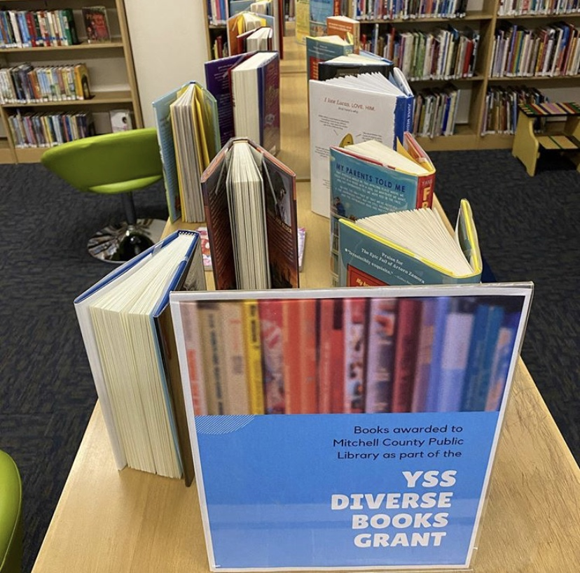
Books arrive!

Slide 3
Roan Readers
Stacey Lane founded Roan Readers as a book club for elementary school students that would foster a love of books and reading. She remains the heart and guiding light of the effort. Today Roan Readers is a partnership between community volunteers, the AMY Regional Library System, Rural Education Partners of Mitchell County, Mitchell Transportation and Ingles Markets. It’s a true community collaboration and partnership, and a model for what can happen when everyone works together, each doing their part, for all our kids.
~ Lori Gilcrist with Rural Education Partners of Mitchell County

Slide 4
What does a library do when Covid cancels in-person programming?

Slide 5
We created a Storywalk featuring the book I Walk with Vanessa by Kerascoët
http://www.amyregionallibrary.org/wp-content/uploads/2020/08/Storywalk-Map.pdf

Slide 6
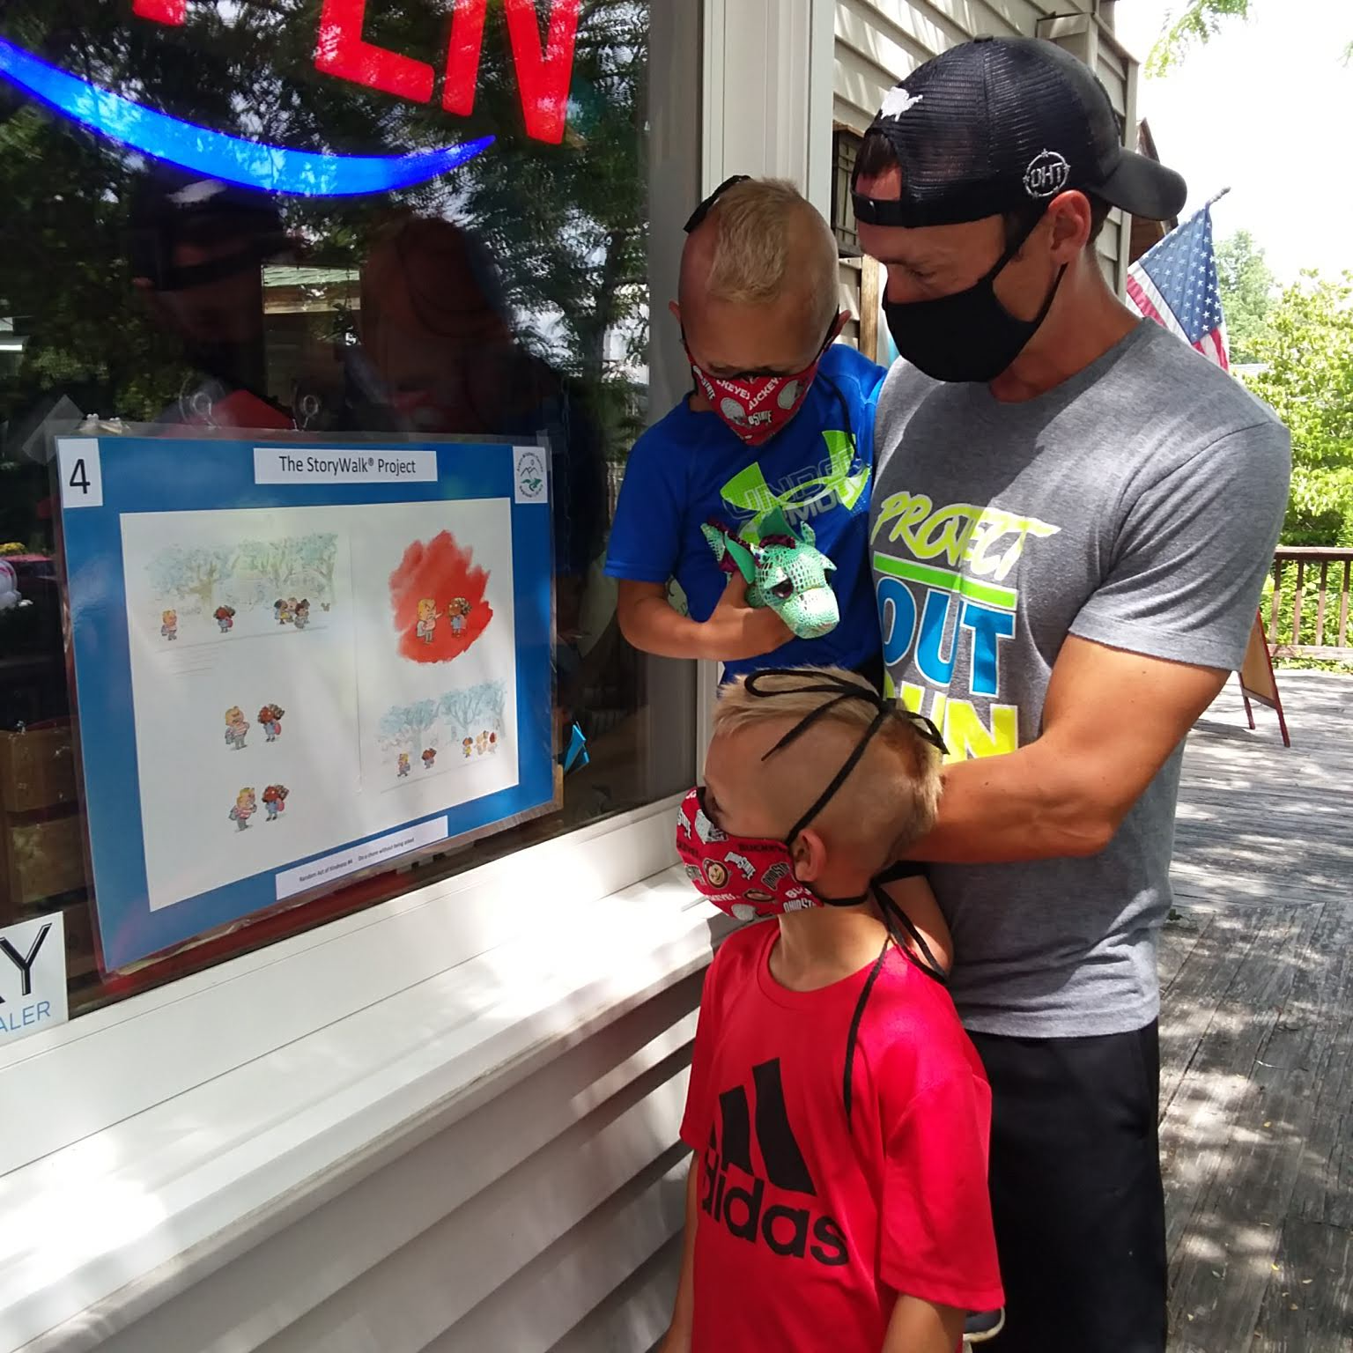
This Daddy and his two boys from Ohio, checking out two pages of the library's StoryWalk on the window of Southern Drifters Outfitter. Mom was tending the baby in the shade.

Slide 7
The Padezzi family visiting from West Palm Beach, FL, looking at two pages of a children's book in the window of Yummi Yarns during the library's new StoryWalk.

Slide 8
The StoryWalk was a success in our region, a second one featuring I Walk with Vanessa is upcoming, and a permanent StoryWalk is now in the works! We plan on keeping inclusivity and diversity front and center in the books we choose for these StoryWalks.
Thank you so very much YSS Committee!

