Slide 1
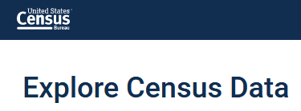
Census Data Tools
Michele Hayslett, Data Librarian
UNC at Chapel Hill
GRS/BLiNC Virtual Workshop
06/16/2020
Notes:
Talking today about tools to access aggregate Census data.

Slide 2
(Note: Use the chat to ask questions.)

Slide 3
Agenda
Three Tools and Their Strengths
Demo/example searches
Your Questions

Slide 4
data.census.gov
Census Bureau’s official database for most surveys
Provides complete available tables and geographies but only for most recent years (see next slide for archival guidelines)
Filter-driven; Advanced Search makes these apparent
Aims to be easy for beginners because that’s the majority of who uses it (but may be too simplified)
Full Release Notes are linked from the bottom center of the data.census.gov page.
Notes:
Release Notes available at https://data.census.gov/assets/releasenotes/faqs-release-notes.pdf (last updated 6/9/2020)

Slide 5
Records Management Rules
Decennial census: retain and display the current and 1 prior
Current: Census 2010
Prior: Census 2000
Quinquennial (5-year) census: retain and display the current and 1 prior
Current: ECON 2017
Prior: ECON 2012
Annual surveys: retain and display the current and 4 prior (5 for ACS)
Notes:
Surveys outside of these parameters are transferred to NARA, from which researchers and organizations like IPUMS and commercial vendors can obtain them as flat files. There has been some indication that the new system may be able to serve more data than this but it’s unclear whether the Bureau will retrospectively add data or, if so, how much.

Slide 6
Update
Google Chrome is the recommended browser
Able to export smaller tables (less than 400 columns by 400 rows) into Excel. R-click on any cell; or use Download screen to select multiple years and related tables.
The export to Excel will maintain the any changes made to the table layout using the custom filters. Table notes and source information are not included with the export.
Can also copy parts of a table with or without the headers so that content can be dropped into Excel (maximum of 22,000 cells ).
Download screen gives more flexibility for choosing multiple years and tables (but only multiple tables on a single topic)

Slide 7
Known Limitations
Download Center no longer available; must use API or FTP site (at least for now).
No functionality to look up Census geographies of a street address; must use the Census Geocoder tool for that.
Lost links to documentation from an earlier version; have to look up on individual program sites.

Slide 8
Good News
Some previously noted issues have been corrected.
More metadata added so, e.g., searching for “race” gives better results
DataFerrett replacement, /mdat/, is available now in beta.

Slide 9
Other Tools for Comparison
NHGIS
Social Explorer

Slide 10
https://www.nhgis.org/
Free (grant-funded) from Minnesota Population Center but must register (and re-certify annually)
Interface is spare but lots of Help
Best for large downloads (doesn’t do individual geographies but rather classes of geographies)
Data back to 1790
Asynchronous processing so very large extracts may be processed overnight or in a couple of days
Offers both data tables and .shp files for mapping (but not maps)
Notes:
Must state research purpose

Slide 11
https://www.socialexplorer.com/
Commercial
Easiest to use (IMO); menu-driven system
Data back to 1790
Has Population Census (decennial and ACS) data; has County Business Patterns; does not have Economic Census data
Seems like it has all data in all years but not entirely everything – likely to have the most common variables and geographies
Has easy map interface but it has less data than Tables section

Slide 12
Interfaces/Demos

Slide 13
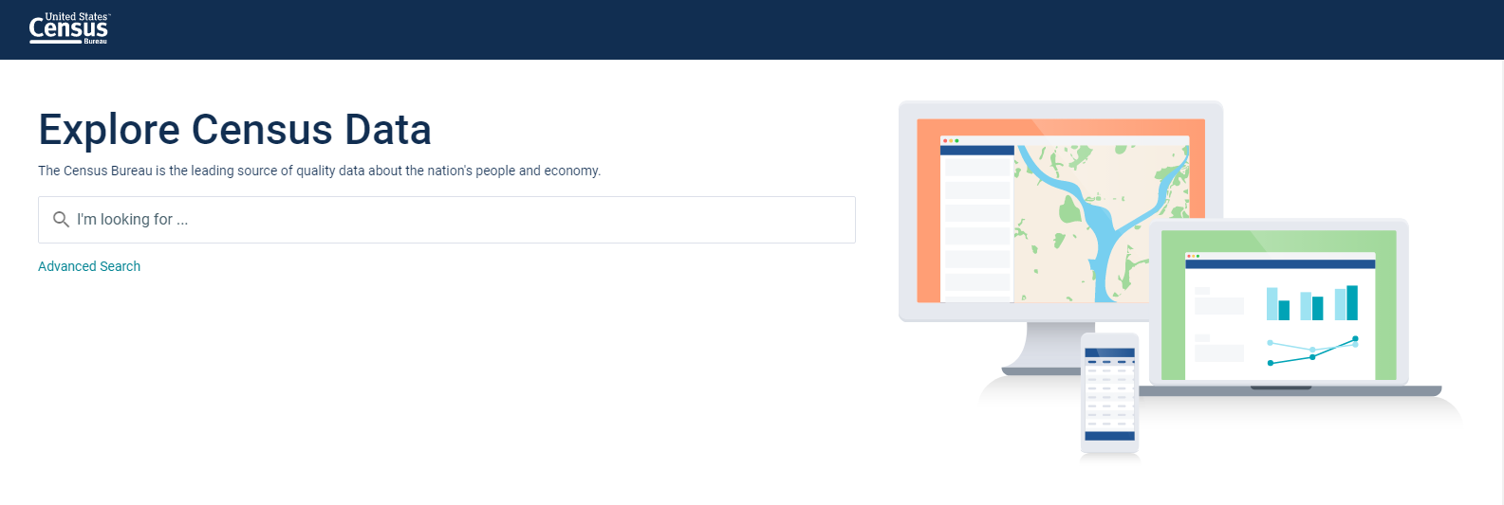

Slide 14
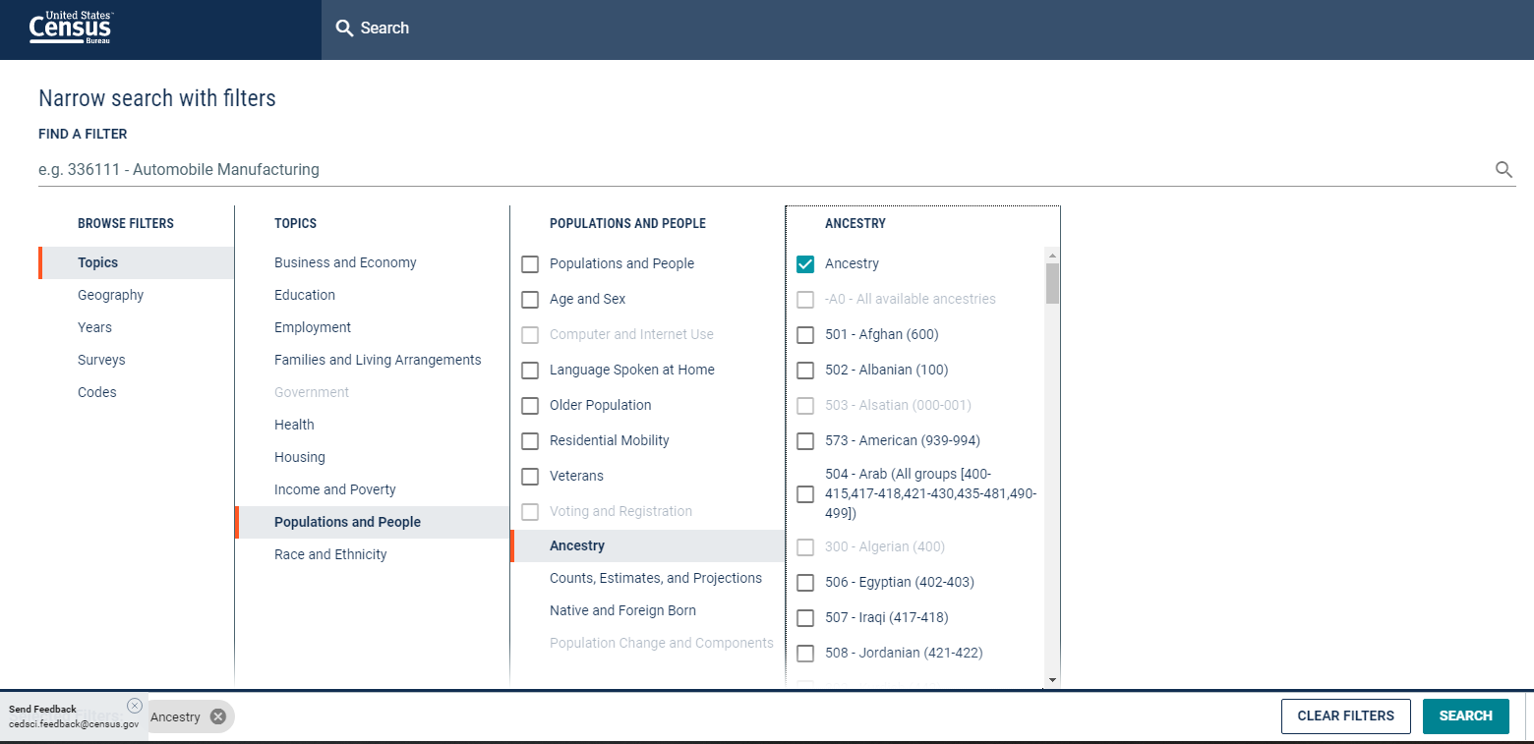

Slide 15
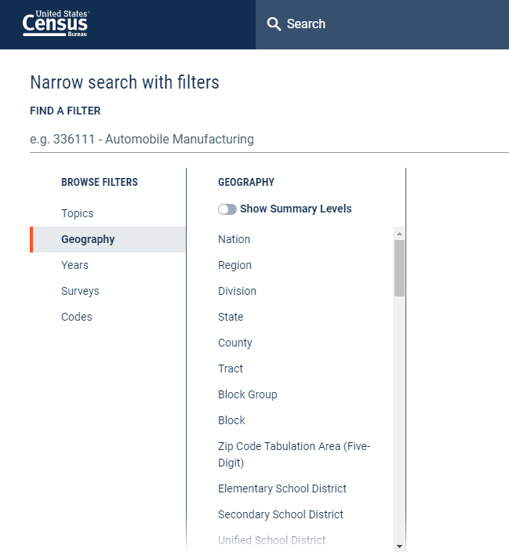

Slide 16
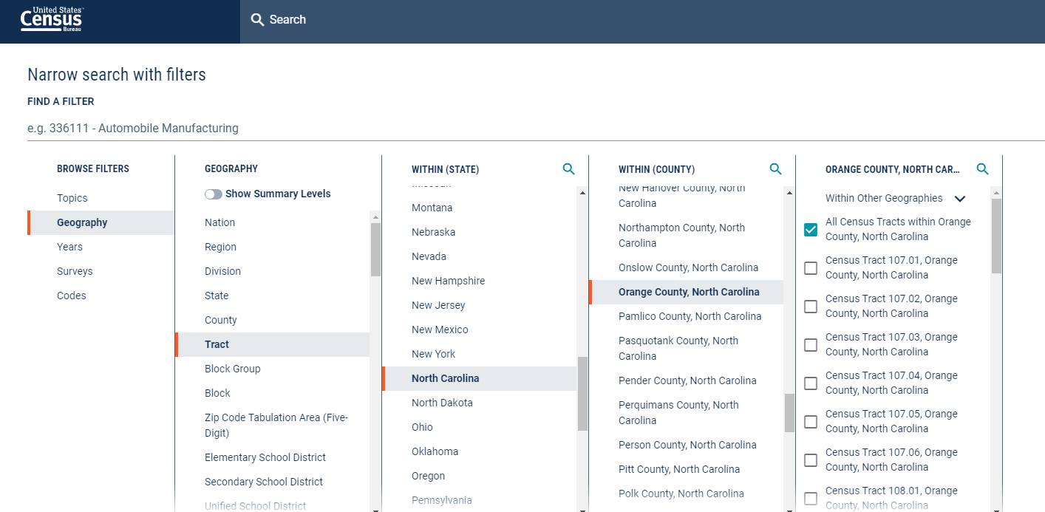

Slide 17
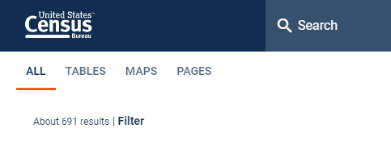
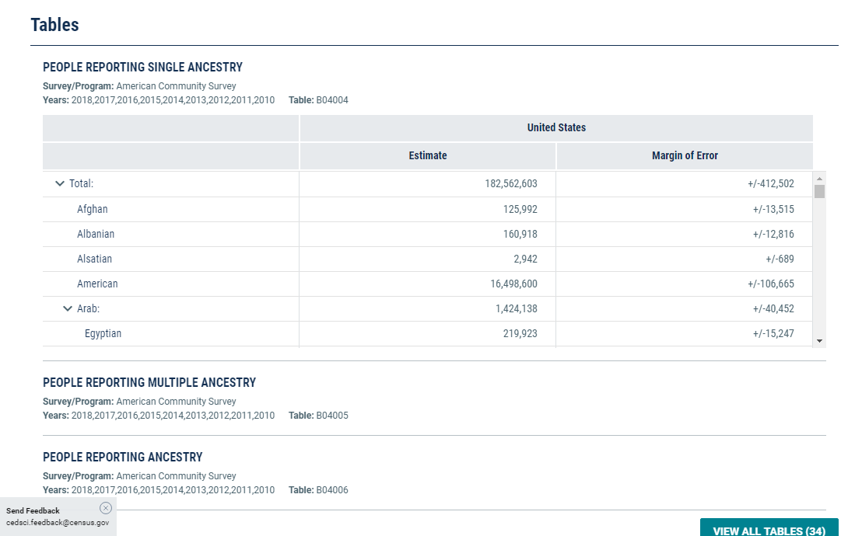
Notes:
Note: maps don’t center on your selected geographies; mine kept ending up in Kansas.

Slide 18
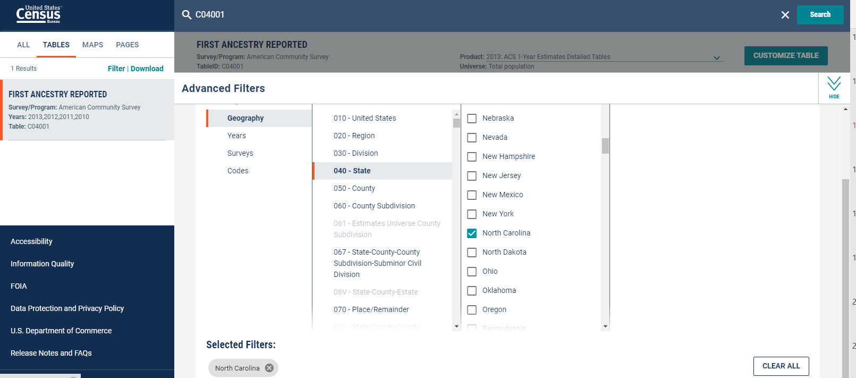

Slide 19
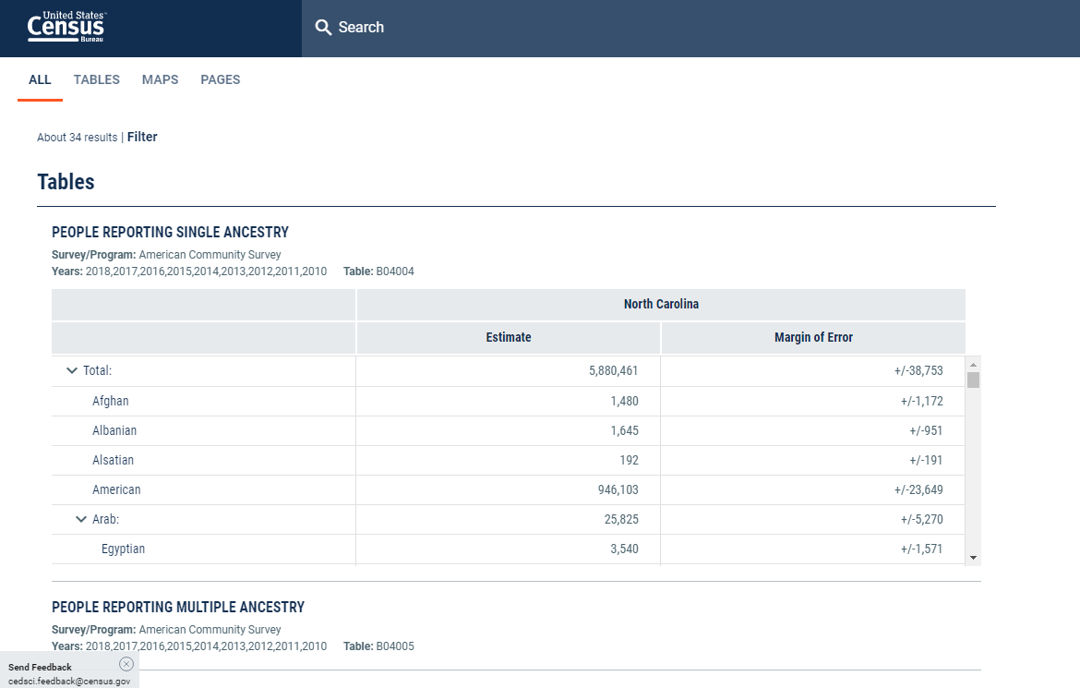

Slide 20
Feedback Is Critical (Now and Always)
What did you search?
What did you find?
What had you expected to find?
Did the search meet your expectation? If not, how could they improve it?
>> Email your feedback to cedsci.feedback@census.gov

Slide 21
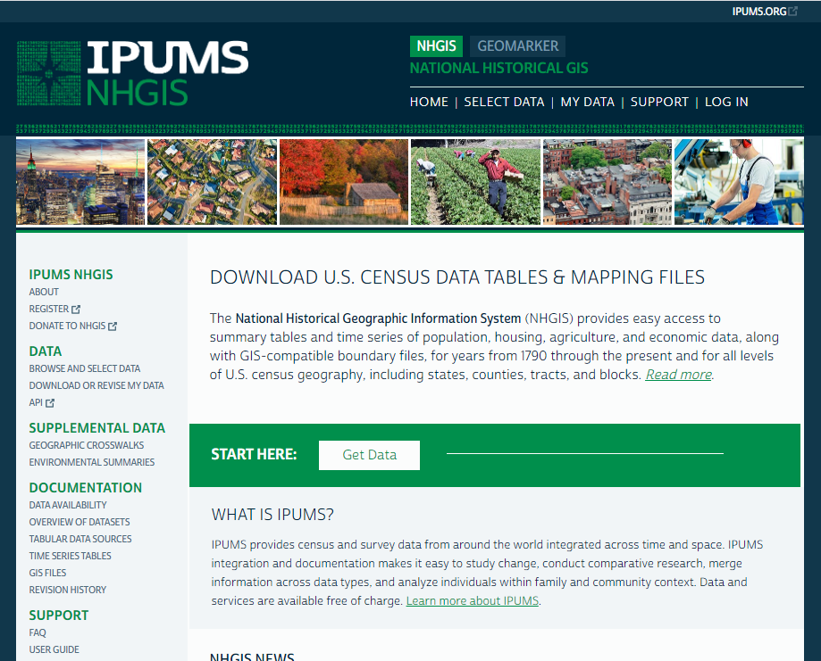

Slide 22
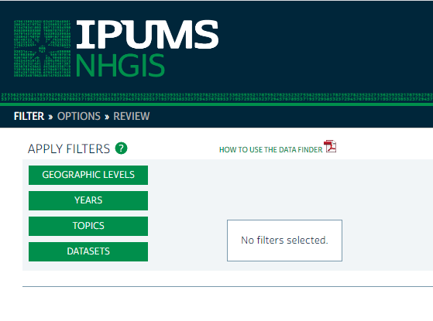

Slide 23
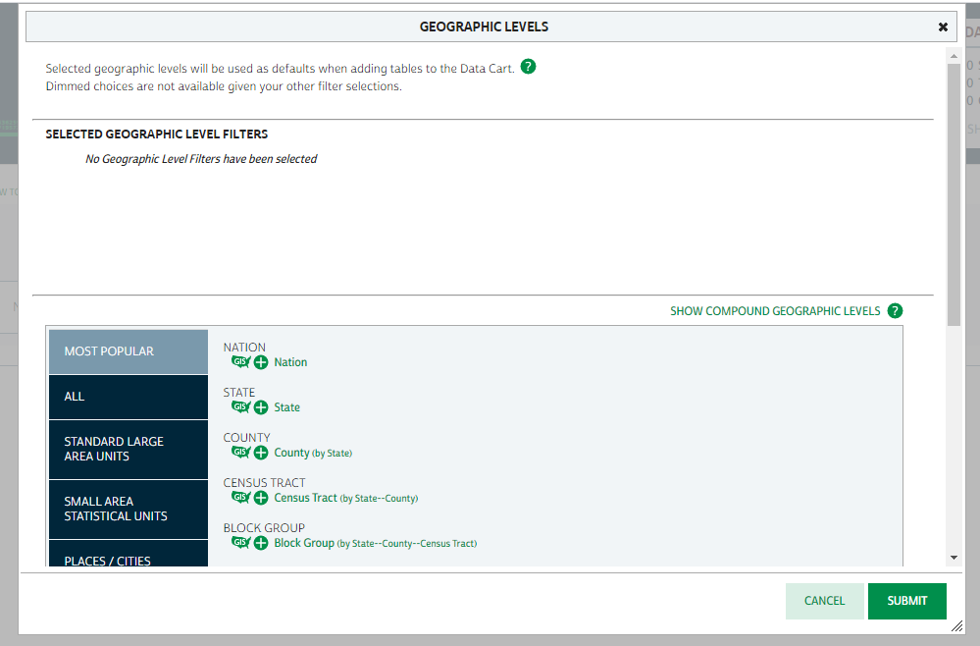
Notes:
Click on the Plus sign (+) to select a geographic level.

Slide 24
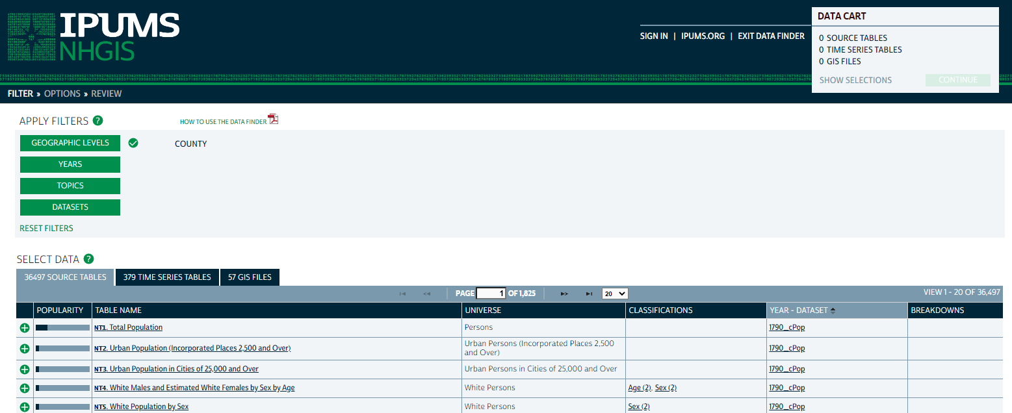

Slide 25
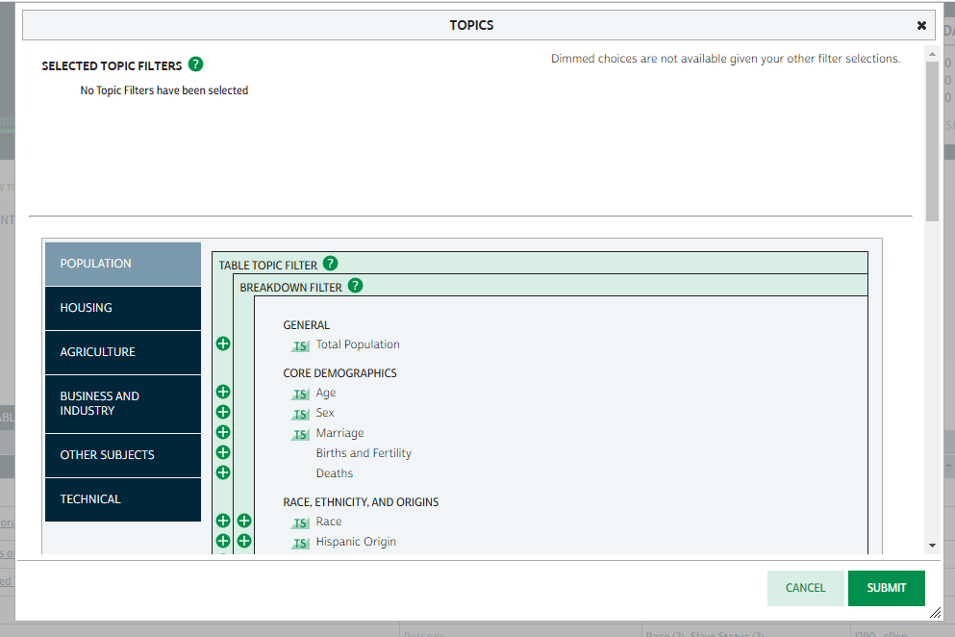
Notes:
Found ancestry under Race, Ethnicity and Orgins

Slide 26
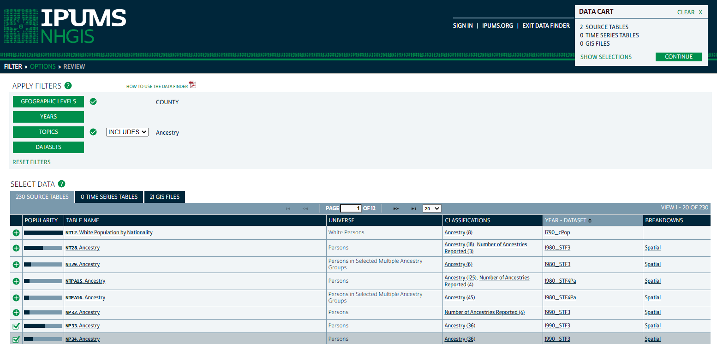
Notes:
These two are exactly the same. You can click on the title for a table shell, but these two are still the same. So a user would have to download them to see how they’re different. This is just for demonstration purposes so I grabbed two tables from 1990, but the more recent data are further down the list (several pages of results—ACS shows up on the second page).

Slide 27
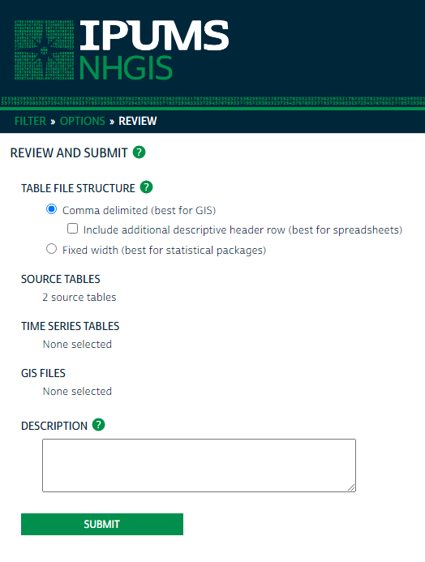

Slide 28
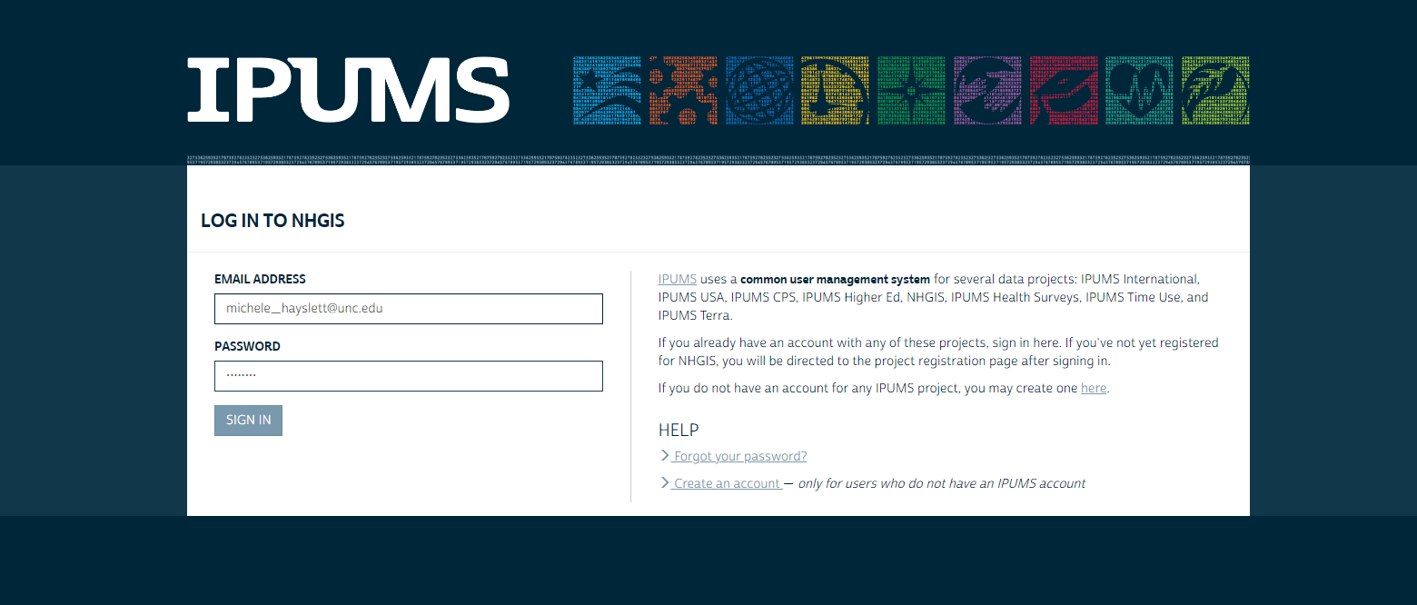
Notes:
Note you can create an account at this step if you didn’t already do that, with the link at the lower right. When you fill out the registration form, it asks for a description of your research that must be AT LEAST 50 words. If your description is shorter, just keep typing nonsense characters and spaces until you reach the minimum (they get that all the time).

Slide 29
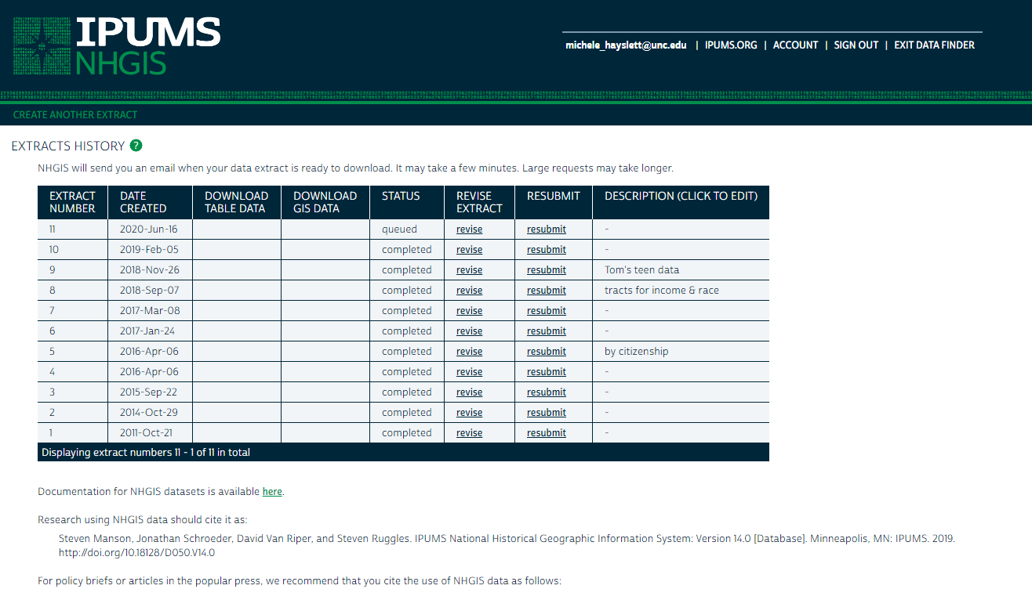
Notes:
When the extract has been processed, you’ll receive an email with the link to get back to this page to Download the Table (and/or GIS) Data. It’ll be a compressed/zipped file that you have to unzip.
Suggested citation at the bottom of this screen to copy for the researcher’s bibliography.

Slide 30
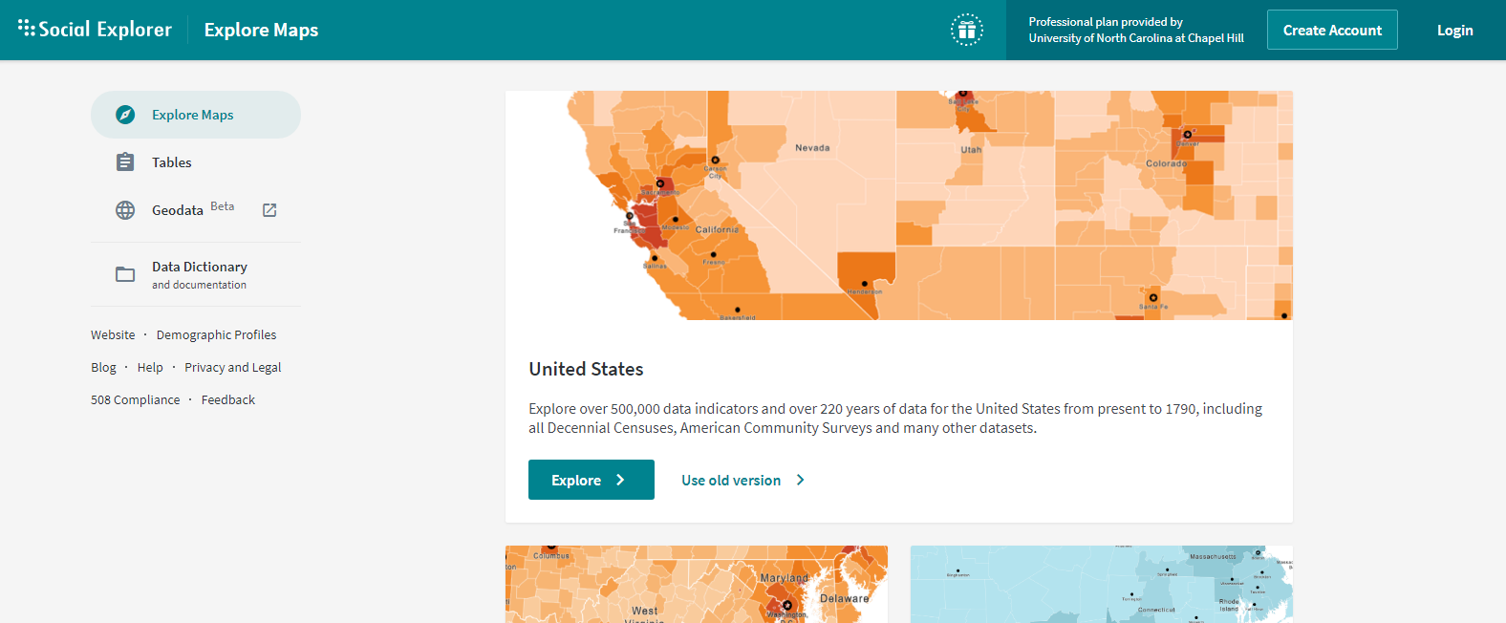

Slide 31
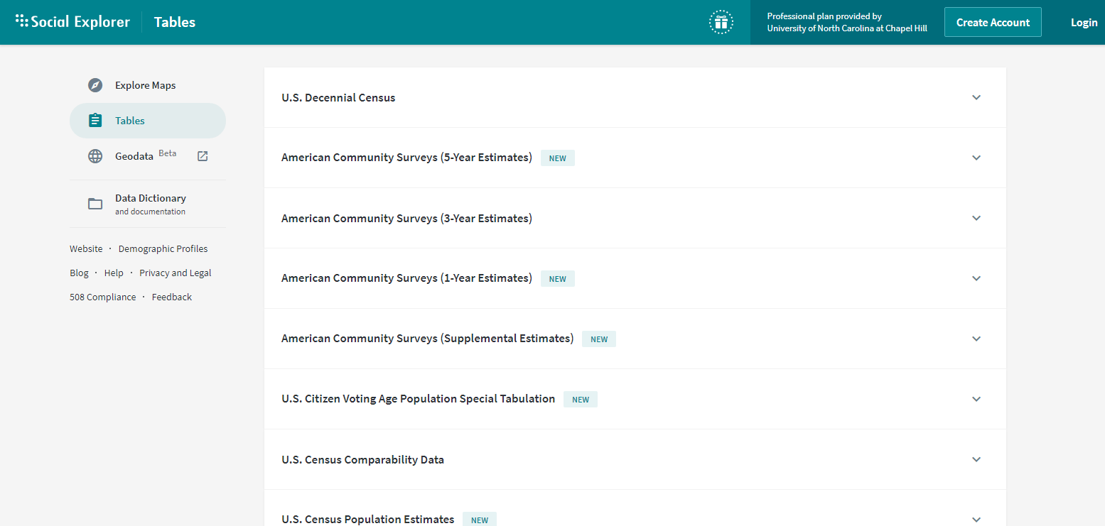

Slide 32
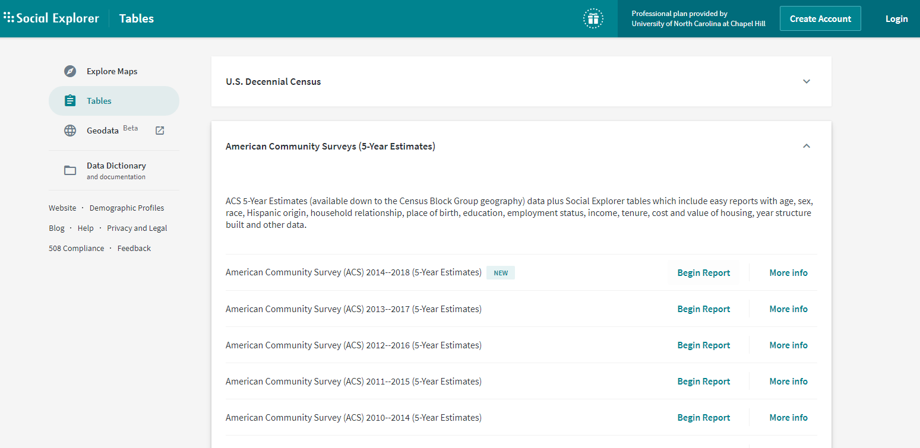

Slide 33
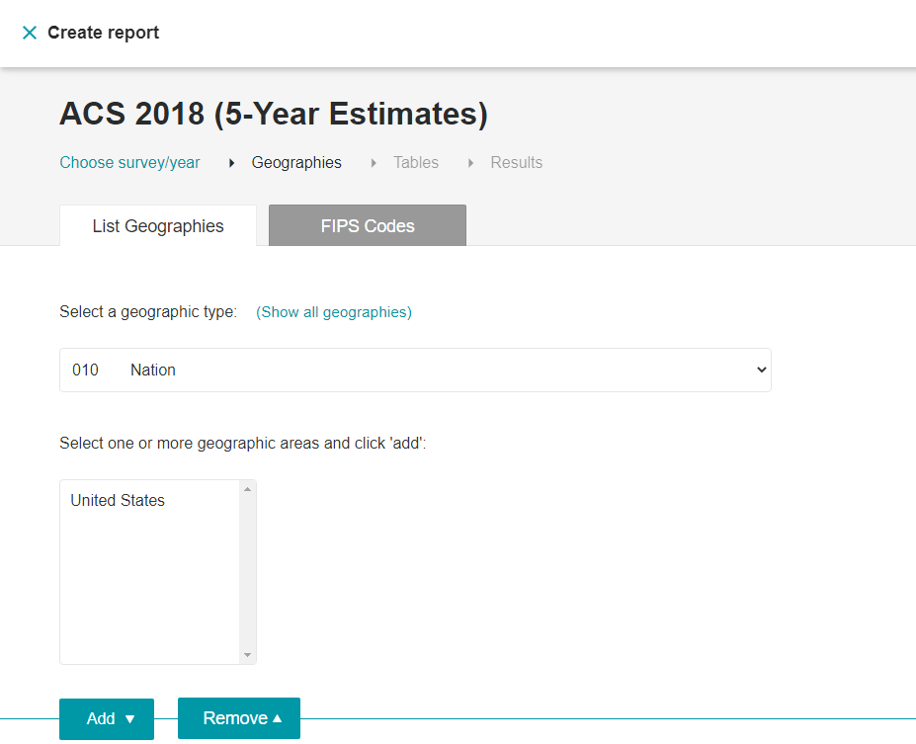

Slide 34
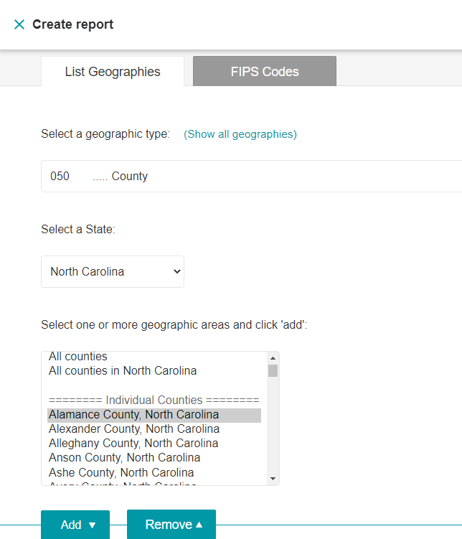
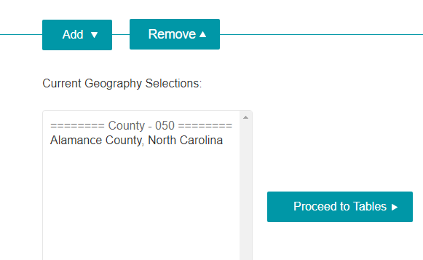

Slide 35
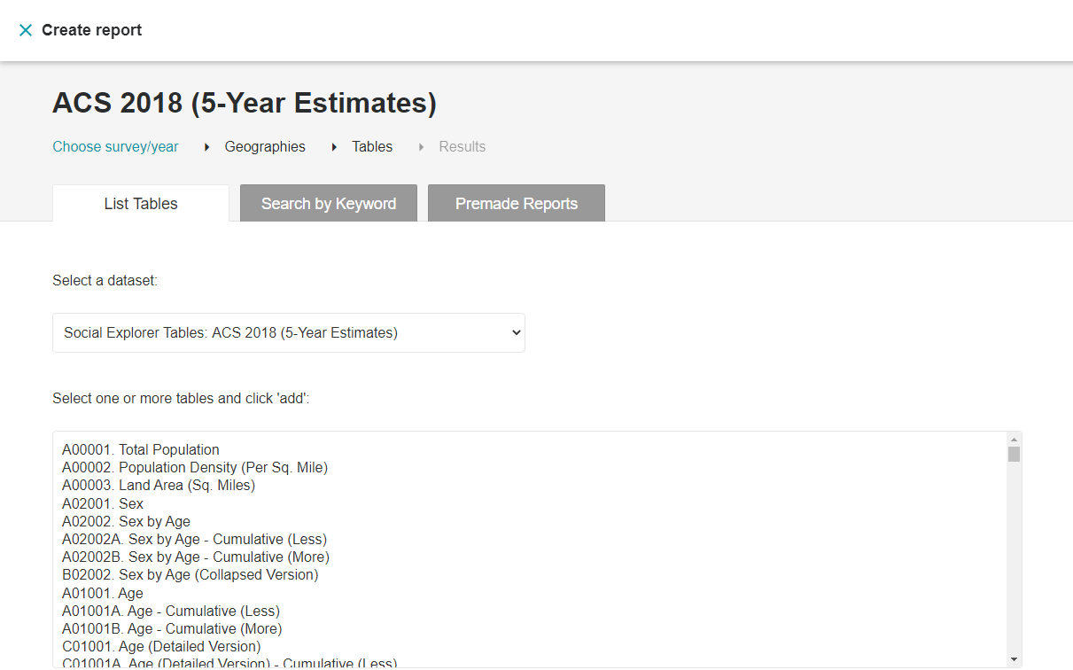

Slide 36
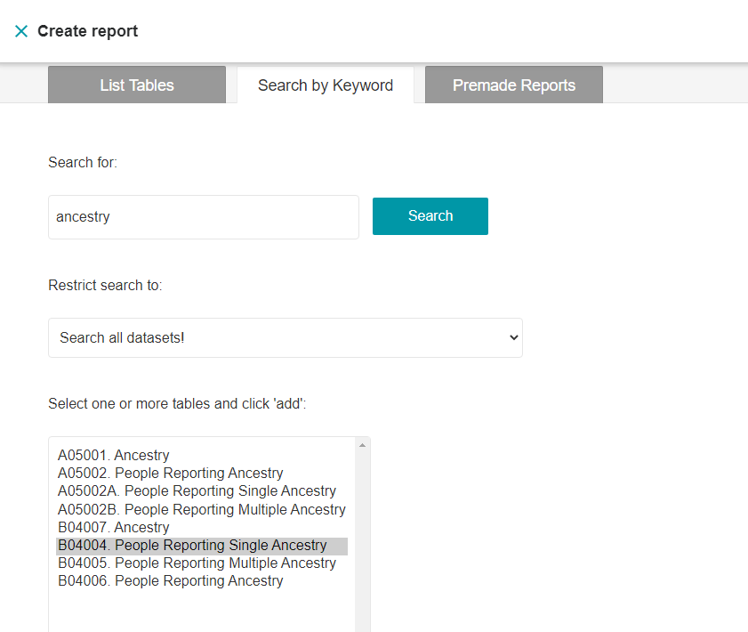

Slide 37
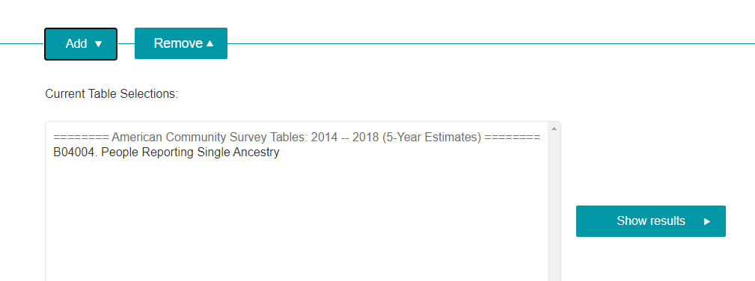

Slide 38
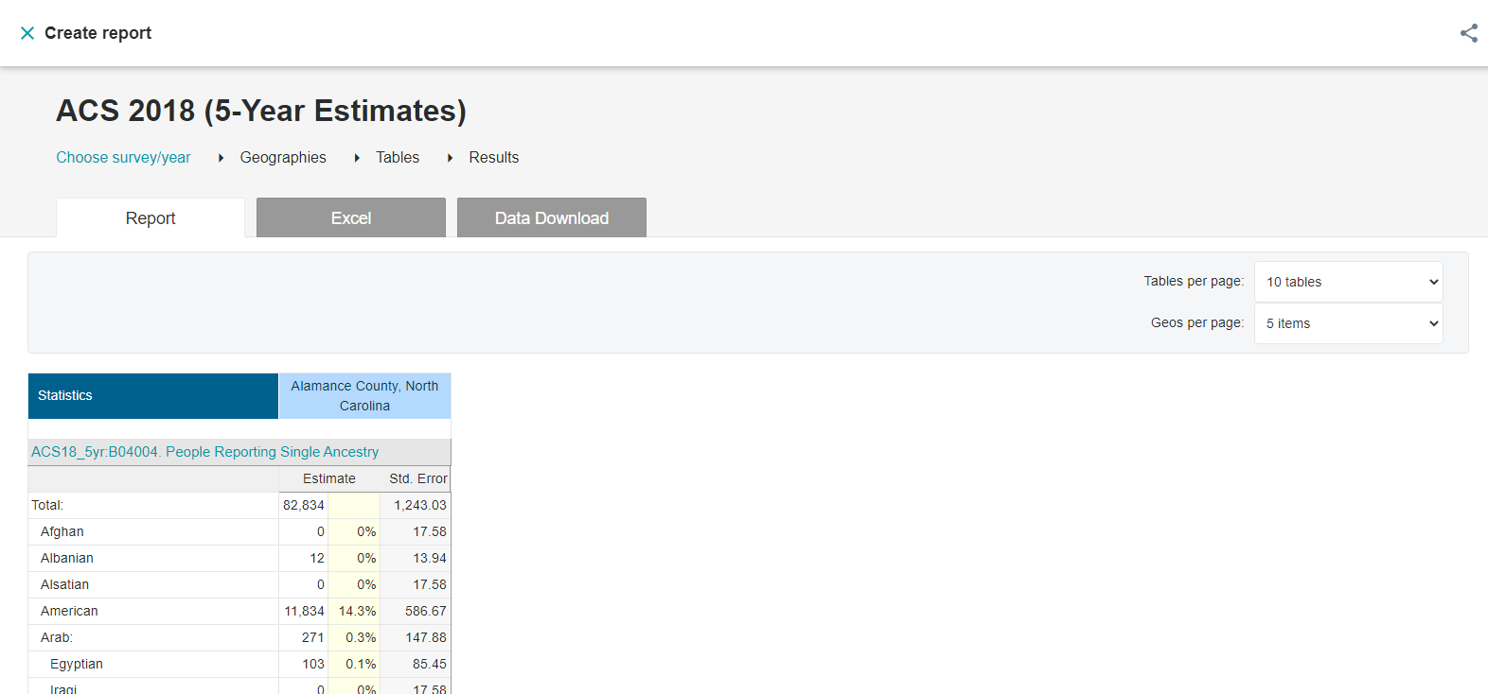

Slide 39
Contact Info
Michele Hayslett
Librarian for Numeric Data Svcs & Data Management
919-843-6958
michele_hayslett@unc.edu
Virtual appointments available at https://guides.lib.unc.edu/michelehayslett

Slide 40
Your Questions/Requested Searches
When will the 2029 2020 Census final analysis be available/reported publicly? ~1 year; see Notes
Internet use (X but Type of Internet Subscription ✓) and PC/device ownership (✓) per household and by age/race/economic status (✓ but only for Type of Internet Subscription).
Educational attainment (✓ in Population Census); also locating business counts by county or metro area (✓ in Economic Census, Geographic Series [every 5 yrs] or the County Business Patterns [annual])
Comparing a variable across Census Tracts within a County and showing a map. (✓ [sort of])
How to find the highest-level ACS survey data in the table view of the data portal -- is there a level higher than the specific "social" "economic" "demographic" and other data profiles, which would show the entire ACS survey together rather than as 4-5 separate tables? X - Unfortunately, the four Demographic Profiles (DP) tables are only presented separately (Demographic; Social; Housing; and Economic Characteristics).
Notes:
Usually apportionment (state-level) counts due by Jan of following year to the President and redistricting data to Congress/publicly by March 31st. B/c of COVID-19 delays, CB has asked for delayed deadlines of April and July.
Pew Research Center only source of Internet usage I know of

Slide 41
Your Requested Searches/Questions
Tax reports and changes or updates on tax submission every year
>> The Census Bureau doesn’t report any income tax data; there is some info on Real Estate Taxes Paid.
How can Entrepreneurship students determine how many competitors they have in their geographic area?
Search “firms”; Add Filters and select the geography and industry wanted (don’t have to have NAICS code; can keyword search an industry).
Econ Census (and Business Patterns) only go to county (or zip code) level. Even some of those suppressed to protect confidentiality.
Ancestry data within multiple census tracts - ✓
the new microdata search capability in data.census.gov
Outside the scope of this session but may be able to do a future session on microdata; some comparison info in the tables on slides 43-44.

Slide 42
Your Questions
How long has census.gov been in existence? >> mid-90s-ish
Where do pre-2000, -2010 ACS and Decennial Census data live, since they're not in the new data portal. Not with the Census Bureau – see archiving guidelines on slide 5. Also, is there a way to bulk download multiple tables and years without using FTP or purchasing a custom table? Yes, select in Download screen or R-click on any cell (not unlimited, though)
Is there a way to use the census to determine information about specific age groups closest to the library to assist in program planning and advertising? Yes! (see slide 48)
How does the census affect business? >> $1,800 per person in Federal and state funding (see 49)
Is there an API for the economic census? Yes!
>> See https://www.census.gov/data/developers/data-sets.html
What is a recode? >> making a new variable, e.g., by summing existing categories.
Notes:
DataFerrett – 1995. American FactFinder debuted 1999; rvsd. 2011.
Note that for ACS tables, the Download screen automatically selects both the 1- and 5-year files. A maximum of 22,000 cells can be copied and pasted into Excel. Smaller tables (those with less than 400 columns by 400 rows) can be exported to Excel. Larger tables are limited to export to .CSV format. Excel can easily interpret .csv files but has an upper limit on the number of cells it can import.
Right-click your mouse on any cell in the table and select “Export Table” >> Select either “Export to CSV” or “Export to Excel.”
Often create recodes with microdata.

Slide 43
Microdata Tools
DataFerrett, https://dataferrett.census.gov/
Now data.census.gov/mdat
IPUMS USA, https://usa.ipums.org/usa/
IPUMS Terra*, https://usa.ipums.org/usa/
Federal Statistical Research Data Ctrs https://www.census.gov/about/adrm/fsrdc/locations.html
Notes:
IPUMS Terra allows getting microdata or aggregate.

Slide 44
Comparison Table
Tool | Decennial/ ACS | Aggregate/ Microdata¹ | Current/ Historical | Ownership | Bulk Download
data.census.gov | Both + many more | Aggregate | Current | Government | (sort of)
mdat (β) | Currently ACS & CPS only | Microdata | Some of both | Government | No
Federal Statistical RDCs² | Both + many more | Microdata | Both | Government | No
IPUMS USA | Both | Microdata | Both | Non-profit | Yes
NHGIS | Both | Aggregate | Both | Non-profit | Yes
Social Explorer | Both + much more | Aggregate | Both | Commercial | Yes
Terra | Both + international, & environmental | Both | Both | Non-profit | Yes
(Notes on slide 45)

Slide 45
Comparison Table
Tools | Tables/Maps | Online? | Register? | Application Time | Cost
data.census.gov | Both but only reference maps | Yes | No | N/A | Free
mdat | Tables | Yes | No | N/A | Free
Federal Statistical RDCs² | Tables | No | Yes, apply | 6 – 12 months | $15,000
IPUMS | Tables | Yes, or request data extract | Yes and submit research purpose | Quick, few hours to couple days | Free
NHGIS | Tables; download .shp files | Yes | Yes | Quick, few hours to couple days | Free
Social Explorer | Both | Yes | Yes | N/A | $$$
Terra | Tables; download vector files | Yes | Yes | Quick, few hours to couple days | Free
(Notes on slide 45)
Notes:
Not thematic maps
Registration for one IPUMS tool grants access to all; have to renew annually

Slide 46
Notes
“Summarized” tables are aggregate data about an area, generally offered for public release. Microdata are anonymized responses for an individual respondent and their household, and can be used flexibly to create customized analyses.
Federal Statistical Research Data Centers (RDCs)

Slide 47
Data Now Available in data.census.gov
 | 2000 | 2010 | 2011 | 2012 | 2013 | 2014 | 2015 | 2016 | 2017 | 2018
ACS 1-Year Detailed Tables |  | ü | ü | ü | ü | ü | ü | ü | ü | ü
ACS 1-Year Data Profiles |  | ü | ü | ü | ü | ü | ü | ü | ü | ü
ACS 1-Year Comparison Profiles |  | ü | ü | ü | ü | ü | ü | ü | ü | ü
ACS 1-Year Subject Tables |  | ü | ü | ü | ü | ü | ü | ü | ü | ü
ACS Selected Population Profiles |  |  |  |  |  |  |  | ü | ü | ü
ACS 5-Year Detailed Tables |  | ü | ü | ü | ü | ü | ü | ü | ü | ü
ACS 5-Year Data Profiles |  | ü | ü | ü | ü | ü | ü | ü | ü | ü
ACS 5-Year Comparison Profiles |  |  |  |  |  |  | ü | ü | ü | ü
ACS 5-Year Subject Tables |  | ü | ü | ü | ü | ü | ü | ü | ü | ü
ACS Supplemental Estimates |  |  |  |  |  | ü | ü | ü | ü | ü
Decennial Summary File 1 (SF1) | ü | ü
Decennial Summary File 2 (SF2), AIAN, and Redistricting (PL) Tables |  | ü
Decennial American Samoa Summary File |  | ü
Decennial Year of Entry: Guam, American Samoa, and Northern Mariana Islands |  | ü
Notes:
Data from the Population Estimates Program is not available in data.census.gov at this time. Have to go to the Population Estimates Program data page, https://www.census.gov/programs-surveys/popest/data.html, for that.

Slide 48
Data Now Available in data.census.gov
 | 2000 | 2010 | 2011 | 2012 | 2013 | 2014 | 2015 | 2016 | 2017 | 2018
Decennial 113th, 115th and 116th Congressional District Summary File |  | ü
Economic Census |  |  |  | ü |  |  |  |  | ü
Island Area Economic Census |  |  |  | ü |  |  |  |  | ü
Census of Governments |  |  |  | ü |  |  |  |  | ü
County Business Patterns |  |  |  | ü | ü | ü | ü | ü | ü
Zip Code Business Patterns |  |  |  | ü | ü | ü | ü | ü | ü
Non-Employer Statistics |  |  |  | ü | ü | ü | ü | ü | ü | ü
Survey of Business Owners Company Summary and Characteristics of Business Owners |  |  |  | ü
Annual Survey of Manufacturers |  |  |  |  | ü | ü | ü | ü |  | ü
Commodity Flows |  |  |  | ü |  |  |  |  | ü
Annual Business Survey |  |  |  |  |  |  |  |  | ü

Slide 49
Demographics of an Area
Use the Census Geocoder to find the Census geographies of an address (could instead look at all tracts within a county, or all block groups within a county).
Pick the geographic level to compare – I recommend tracts but consider various geographies by size, listed in the Notes of this slide
Use the Maps in data.census.gov to view surrounding geographies and note identifiers (usually a number for smaller geographies)
Select those geographies in the Advanced Search and obtain individual variables, or DP tables for a selection of common variables.
Notes:
Counties - variable in size
(Geographic levels above tracts are generally ones with political boundaries set by local governments. Tracts and geographic levels below that are administrative geographies used by the Census Bureau, and all are nested progressively within each successive geographic level the way counties are nested within a state. “Places” [that is, cities, towns, villages, etc.] overlap these boundaries.)
Tracts - ~5,000
Block groups - ~1,000
Census blocks - ~100 (not available from ACS due to relatively small sample size; only available from decennial census)

Slide 50
How does the Census affect business?
Hugely! The Population Census results in (in a NC estimate) ~$1,800 in Federal and state funding per person who answers the Census. Some of that funding is in services direct to businesses, e.g., Small Business Administration programs like loans and grant funding. But it also provides information employers use for planning, e.g., about where workers are and where customers are. And other funding goes to support workforce development, e.g., job training and education. And the Economic Census provides a ton of information for businesses about their industries broadly, and in a general sense about their competition and suppliers.
*More on the NC estimate sources: The economic impact of the Census in NC is $1,623 per person per year in federal funding according to the George Washington University Counting for Dollars study and $200 per person per year in state funding according to the NC Office of State Budget and Management.

